Slide 1

HTML
Lesson 3

Slide 2
HTML – Head Elements
Tag | Description
<head> | Defines information about the document
<title> | Defines the title of a document
<base> | Defines a default address or a default target for all links on a page
<link> | Defines the relationship between a document and an external resource
<meta> | Defines metadata about an HTML document
<script> | Defines a client-side script
<style> | Defines style information for a document

Slide 3
HTML – Head Elements
HTML <title> Element
<head>
<title> Title of the document</title>
</head>

Slide 4
HTML – Head Elements
HTML <base> Element
<head>
<base href="http://www.nverner.am/images/" target="_blank">
</head>

Slide 5
HTML – Head Elements
HTML <link> Element
<head>
<link rel="stylesheet" type="text/css" href="mystyle.css" >
</head>

Slide 6
HTML – Head Elements
HTML <style> Element
<head>
<style>
body {background-color:yellow}
p {color:blue}
</style>
</head>

Slide 7
HTML – Head Elements
HTML <meta> Element
<head>
<!-- Define keywords for search engines: -->
<meta name="keywords" content="HTML, CSS, XML, XHTML, JavaScript">
<!-- Define page description: -->
<meta name= " description" content="Page Description">
<!-- Define page author: -->
<meta name= " author" content="Tom Smith">
</head>

Slide 8
HTML – Lists
An ordered list:
<ol>
<li>Coffee</li>
<li>Milk</li>
</ol>
The list items are marked with numbers.
An unordered list:
<ul>
<li>Coffee</li>
<li>Milk</li>
</ul>
The list items are marked with bullets.

Slide 9
HTML – Lists
A Description list:
<dl>
<dt>Coffee</dt>
<dd> - black hot drink </dd>
<dt>Milk</dt>
<dd> - white cold drink </dd>
</dl>
The <dl> tag is used in conjunction with <dt> (defines terms/names) and <dd> (describes each term/name):

Slide 10
HTML – Lists
Types of ordered lists
Value | Description
A | Letters list
a | Lowercase letters list
I | Roman numbers list
i | Lowercase Roman numbers list
<ol type="A" >
<li>Coffee</li>
<li>Milk</li>
</ol>
<ol start="0" type= "1">
<li>Coffee</li>
<li>Milk</li>
</ol>

Slide 11
HTML – Lists
Nested lists
<ul>
<li>Coffee</li>
<li>Tea
<ul>
<li>Coffee</li>
<li>Tea</li>
<li>Milk</li>
</ul>
</li>
<li>Milk</li>
</ul>

Slide 12
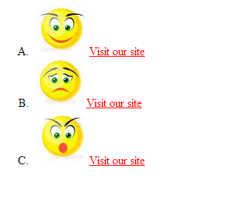
Task:1

Slide 13
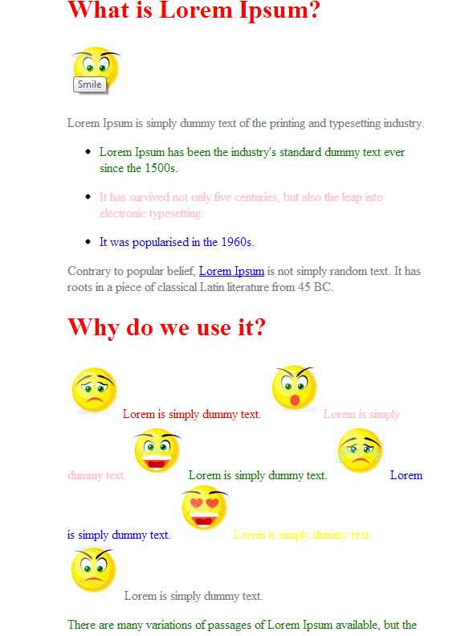
Task:2

Slide 14
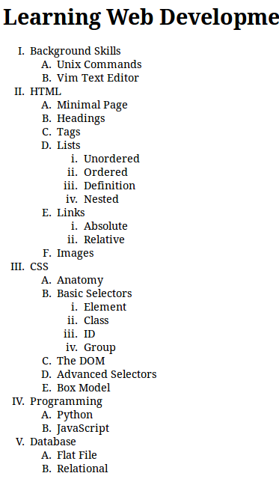
Task:3

